Slide 1
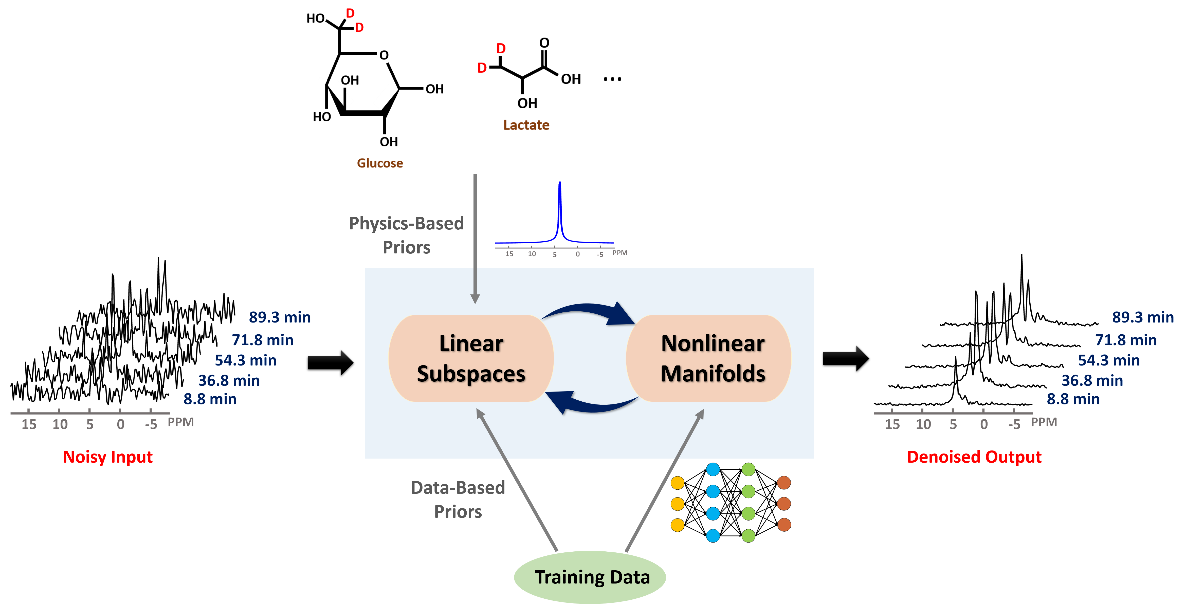
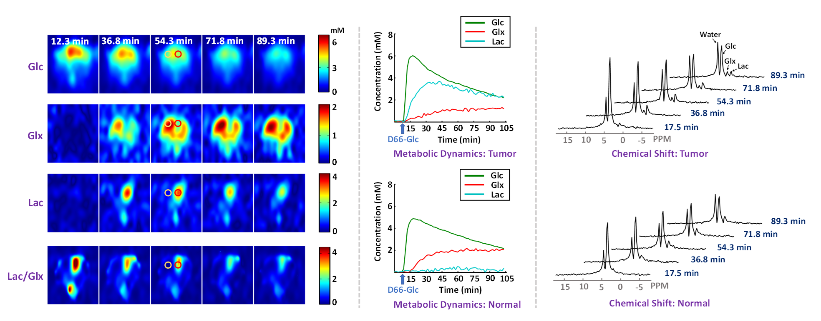

Schematic overview of the proposed learning-based processing framework that enables high-resolution dynamic DMRSI.
High-resolution (10 $μ$L; 1 min) dynamic DMRSI results of rat brain with a small tumor.

Slide 2
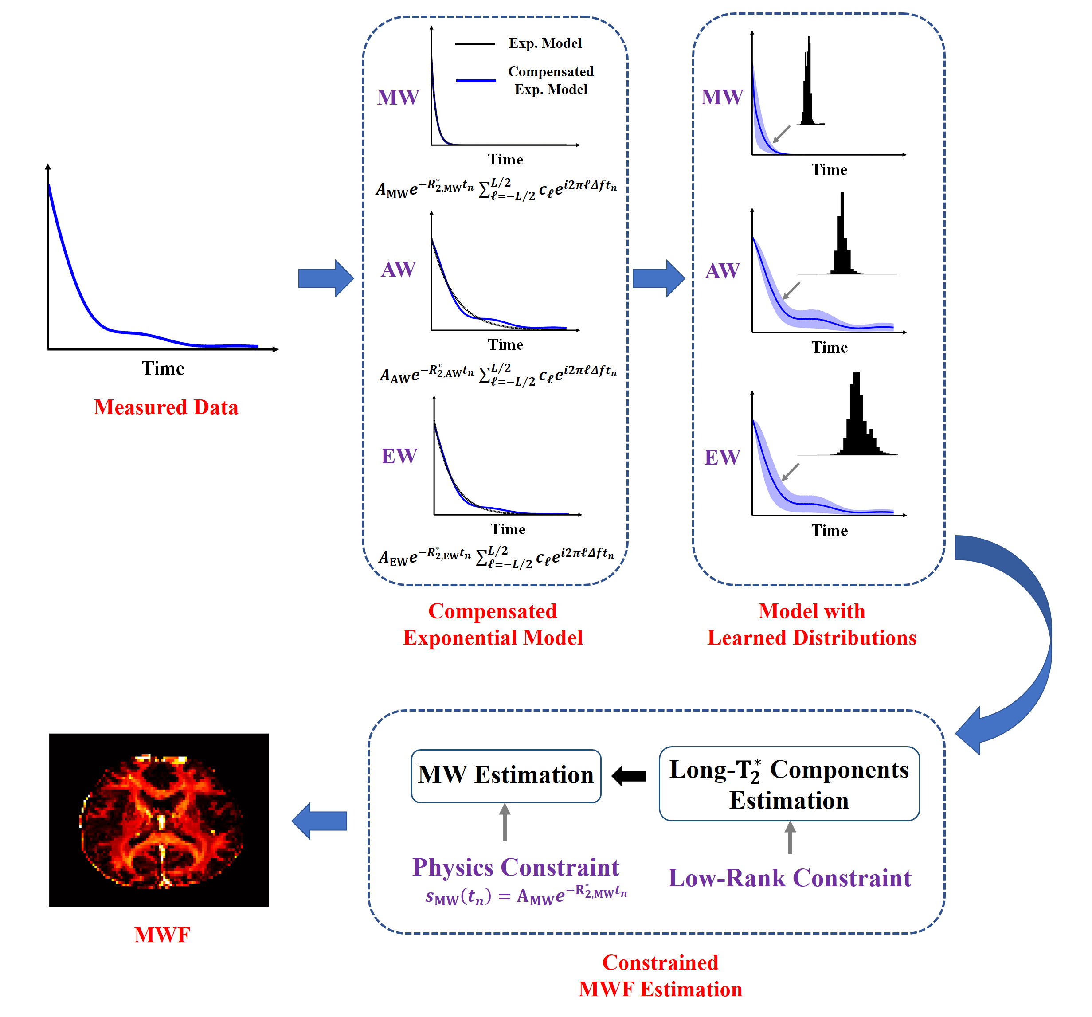
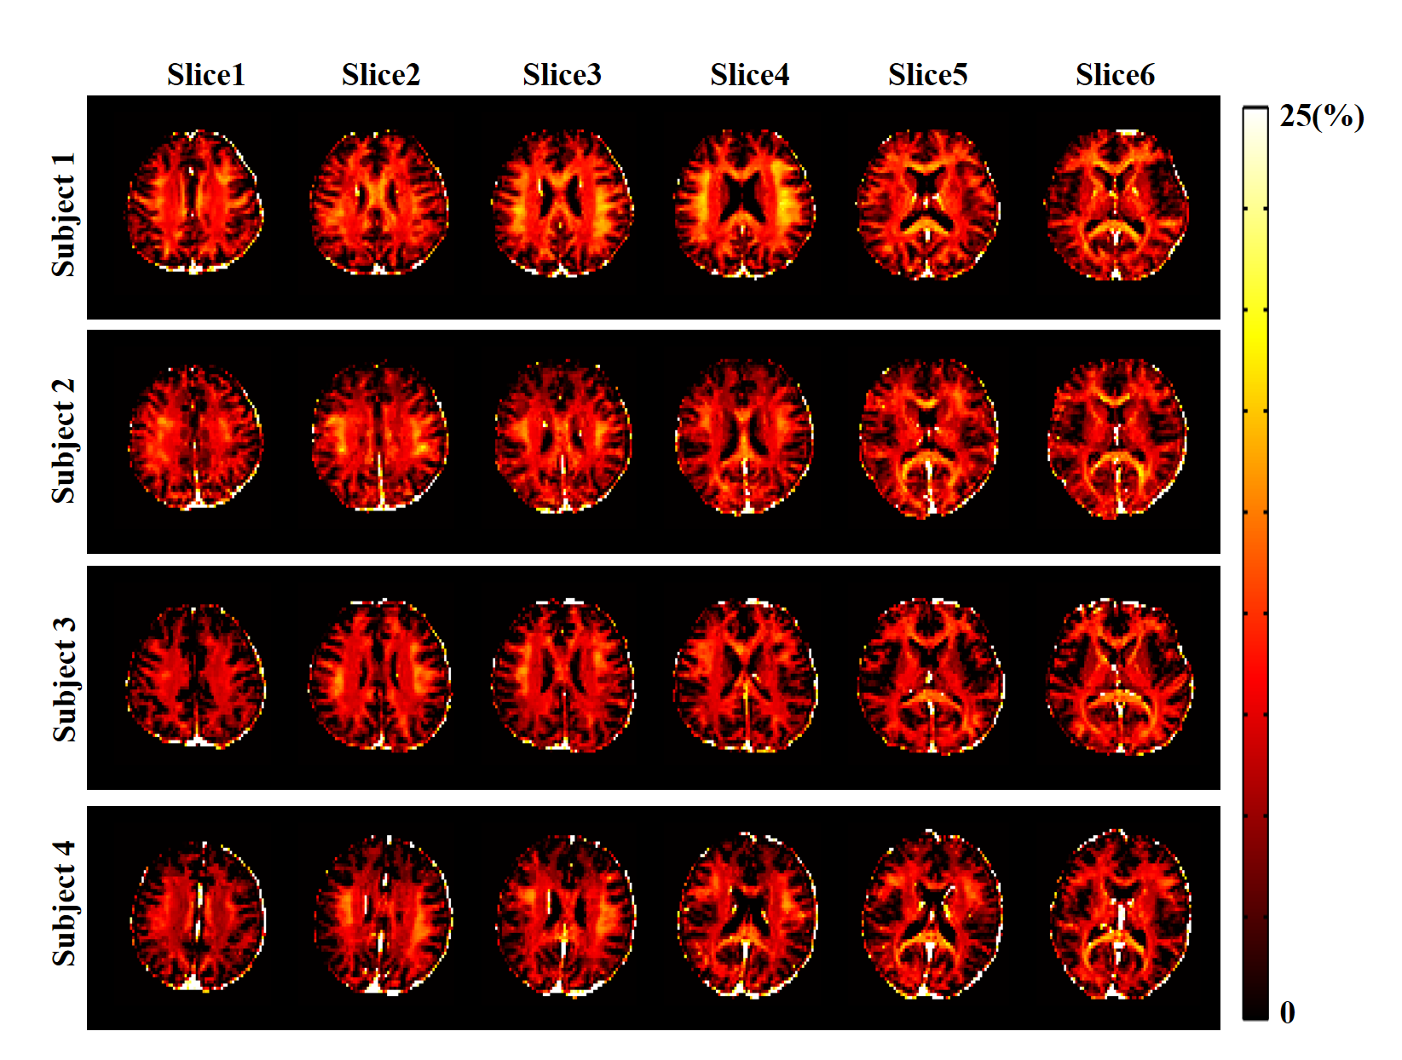
Illustration of the key features of the proposed method: a) a compensated exponential model to better handle practical non-exponential signal variations, b) use of learned parameter distributions to stabilize parameter estimation, and c) constrained MWF estimation scheme.
In vivo results obtained from healthy subjects

Slide 3
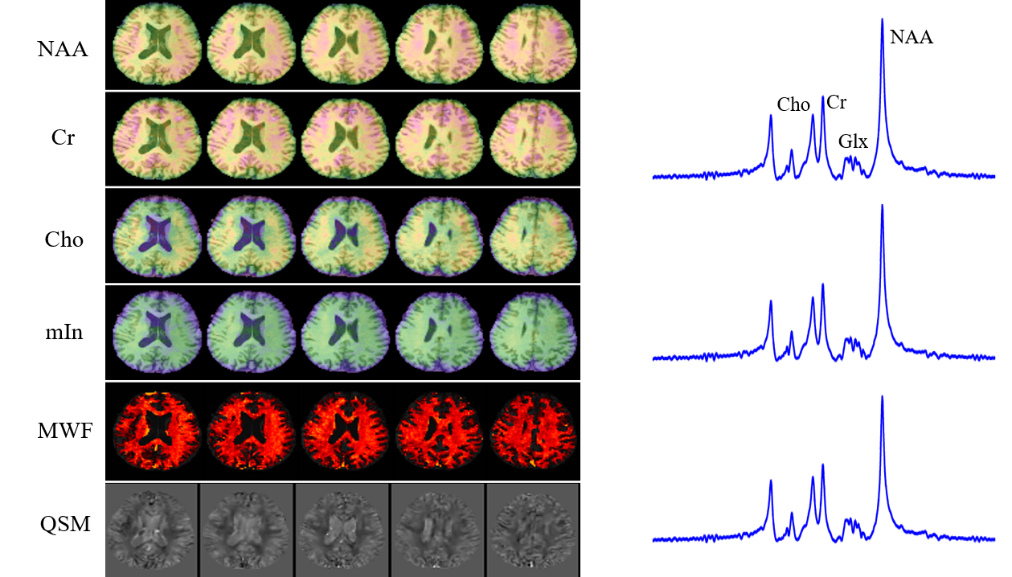
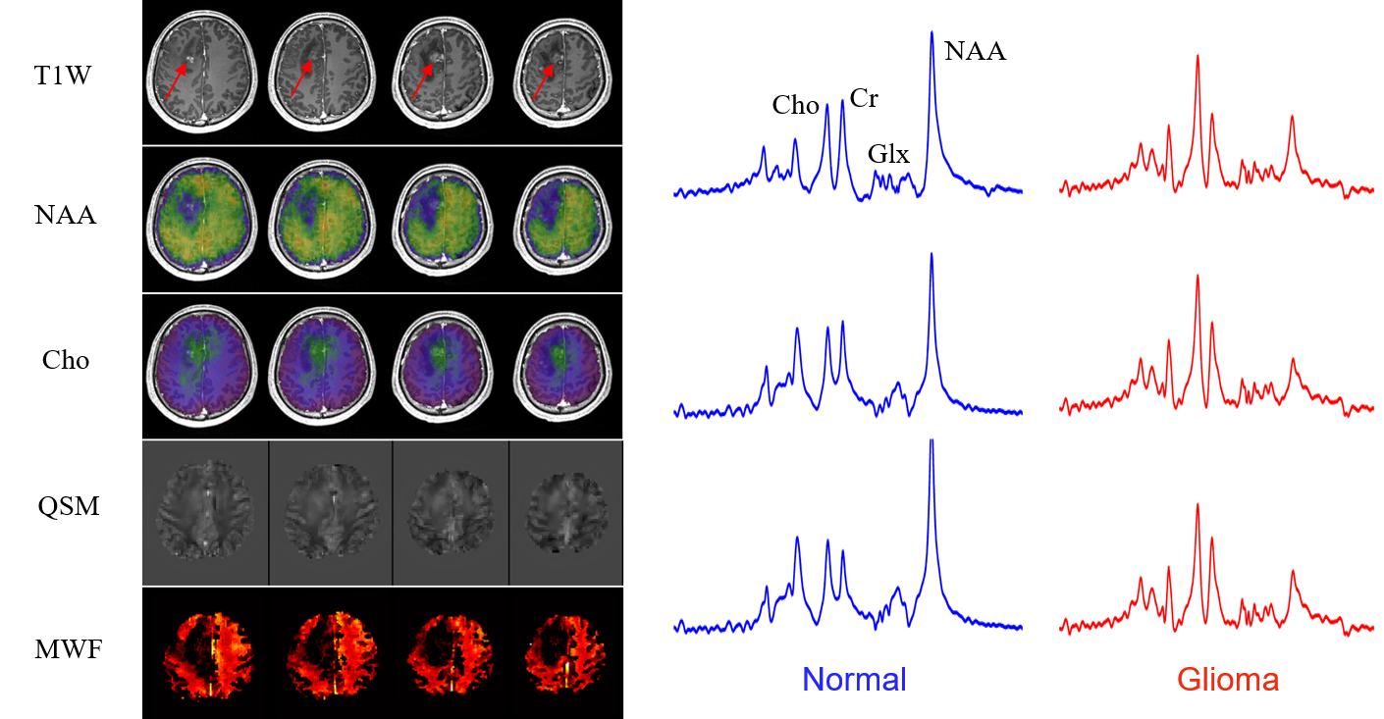
A set of multi-molecular multiple parameter results obtained from one healthy subject.
A set of multi-molecular multiple parameter results obtained from one tumor patient.

